Slide 1

Dust off your Raspberry Pi
Put your Pi to use and learn embedded development
Raspberry Pi is a trademark of the Raspberry Pi Foundation

Slide 2
About me
Douglas Gore
Embedded software engineer (6 years)
Work at Nagra Media UK
Primarily work on Set Top Boxes and PVRs
Love to experiment with technology and ideas in my spare time
E.g. JavaScript MOD player, GameBoy emulator, etc
Find me on Twitter @DougGore

Slide 3
What We will Cover
Introduction to the Pi
The hardware and APIs
Setup
A few interesting programs
High level coding with Qt5 and QtQuick
Low level interfacing
Q&A

Slide 4
Do you do Pi?
Hands up if you own a Raspberry Pi?
Hands down if you have only run XMBC?
Hands down if you haven’t touched it in a month?
Hands up if you have created or ported software on the Pi?
Notes:
Get audience to put their hands up

Slide 5
Introducing the Pi
Broadcom BCM2835 SoC
Hardware accelerated 3D graphics
Hardware video and audio decoding
H.264 video encoding
256MB RAM split between CPU and GPU
Forget that, it’s now 512MB
Same chip as Roku 2
Programmable pins for custom hardware
And most importantly…
Notes:
Roku 2 plays Angry Birds

Slide 6

NOW Built in WaLes

Slide 7
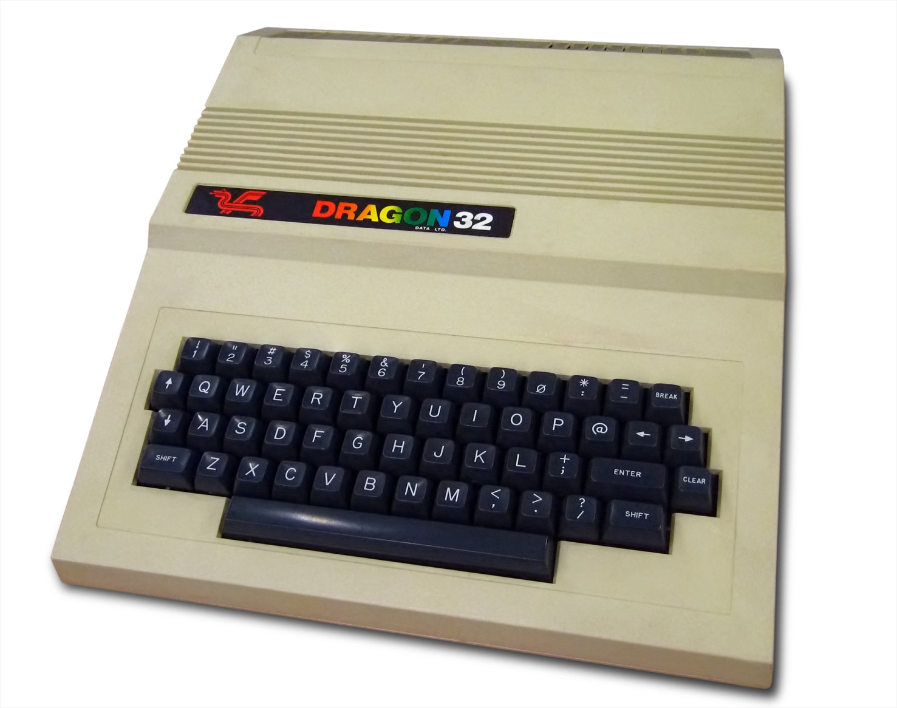
The Last Computer Made in Wales?

Slide 8
…Not Quite

Slide 9
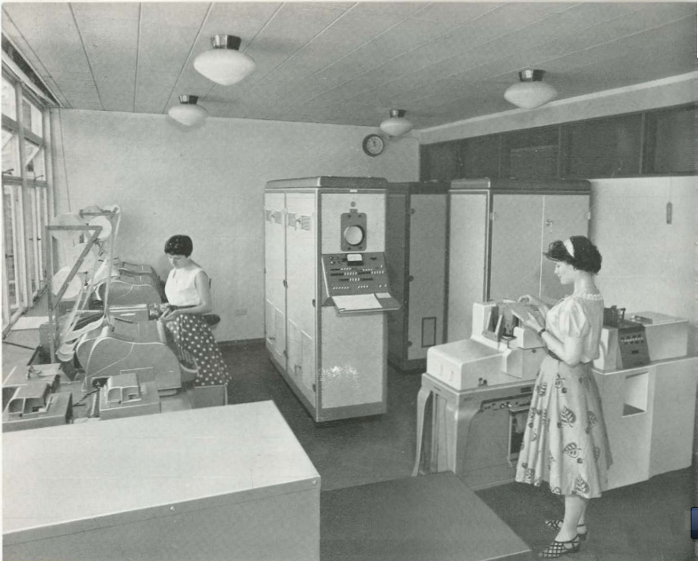
The Zebra
Zeer Eenvoudige Binaire Reken Automaat

Slide 10
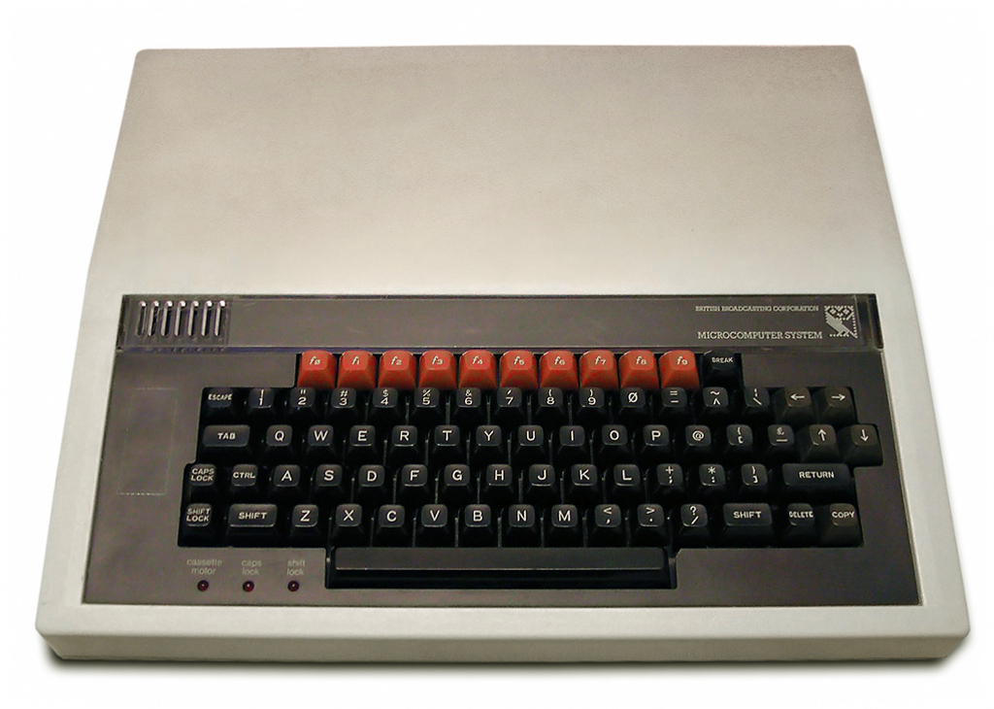
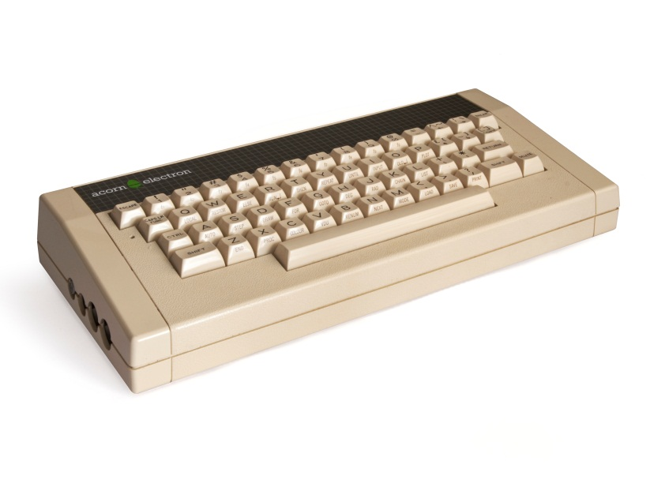
BBC Model B & electron

Slide 11
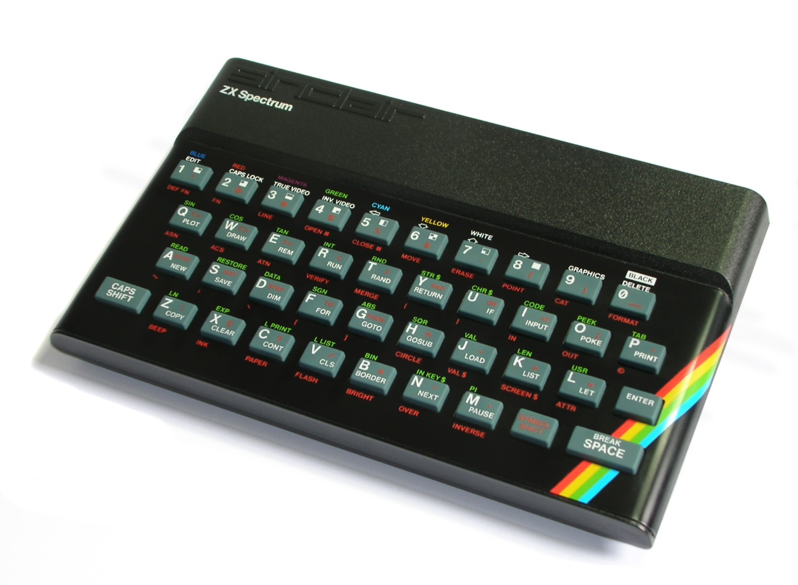
ZX Spectrum

Slide 12
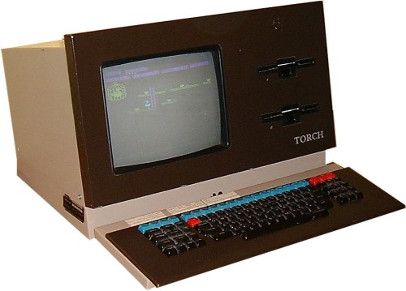
Torch Computers

Slide 13
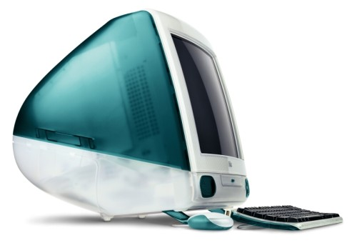
Apple iMAC

Slide 14
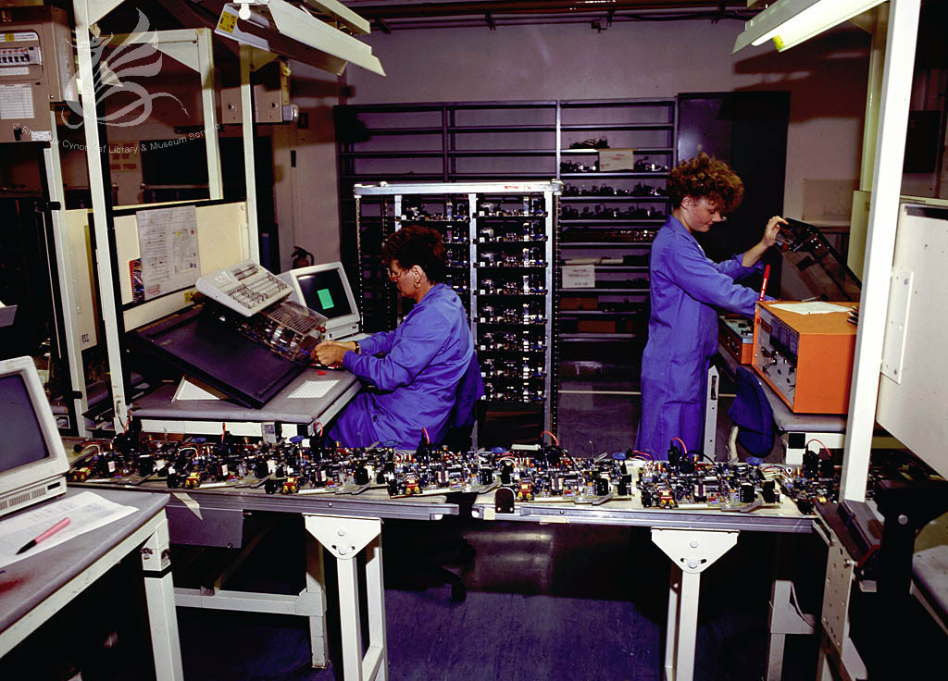
Production in the 80s

Slide 15
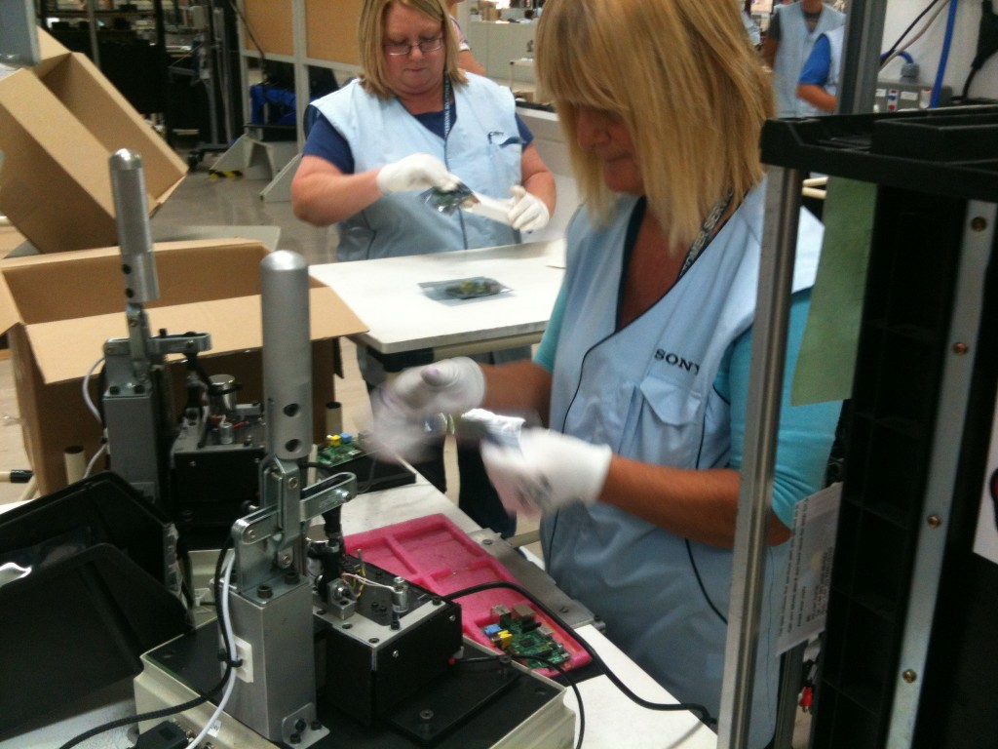
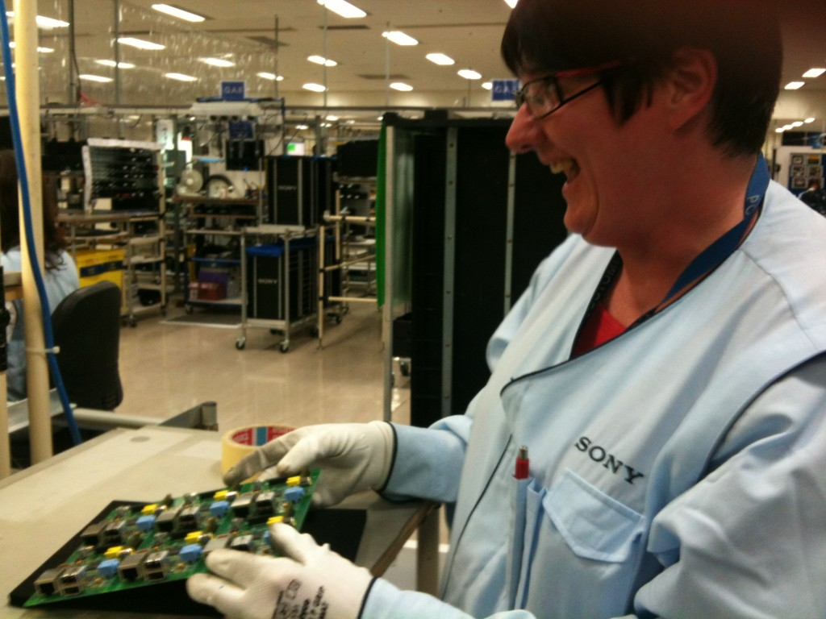
Production now

Slide 16
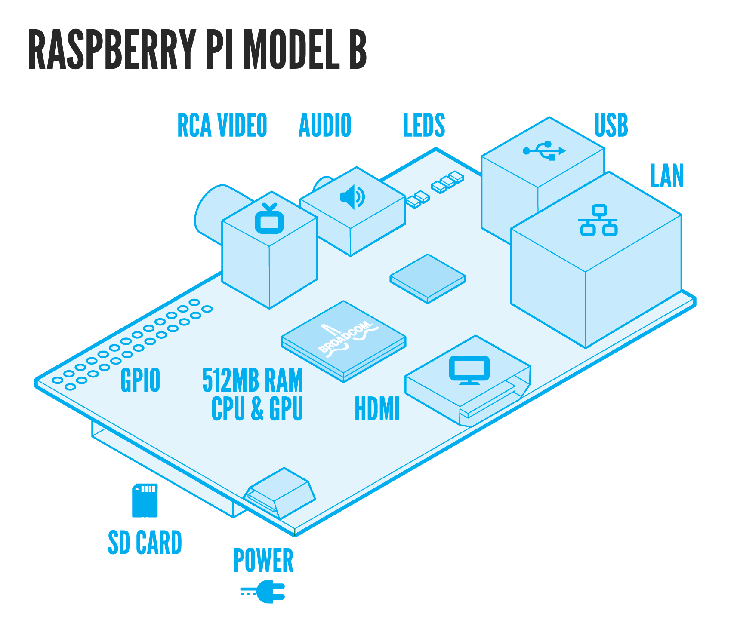
The PCB

Slide 17
What is an SoC?
Slow CPU core, STBs just reaching 1GHz, mobile now approaching 2GHz, many cores
Lots of specialised co-processors for multimedia, DSP, graphics, security
DACs, ADCs, signal generation, front ends often integrated
Push as much processing onto co-processors as possible
Aim is generally to offer something that is just “good enough” for the job to keep costs low

Slide 18
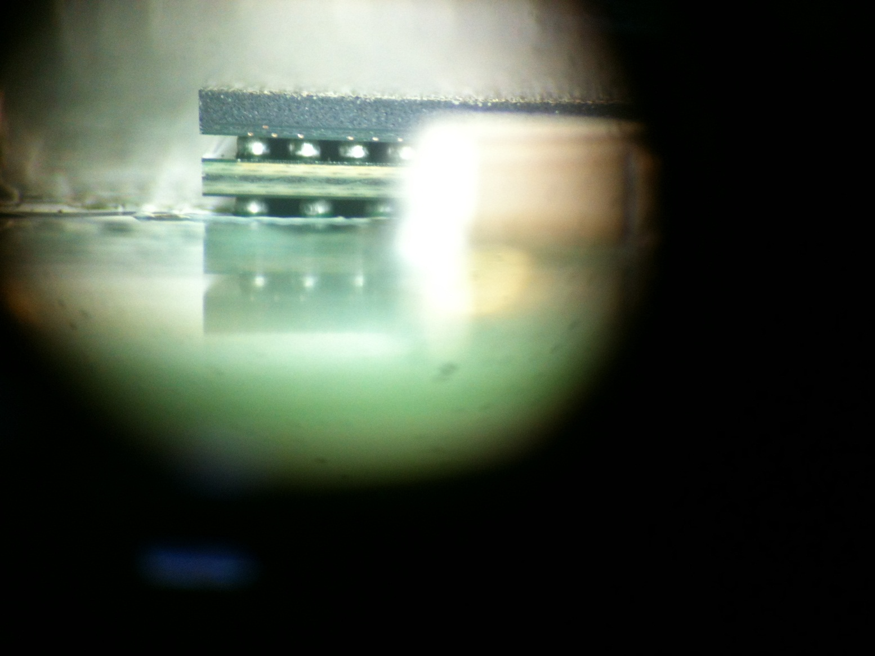
Package On Package (POP)

Slide 19
Hardware acceleration
OpenGL ES 2.0 – 3D graphics
Gaming, slick UI effects, shaders
OpenVG – 2D graphics
Vector graphics, UI compositing
OpenMAX – Hardware audio and video decoding and encoding
The official method and only sane way to doing AV decoding

Slide 20
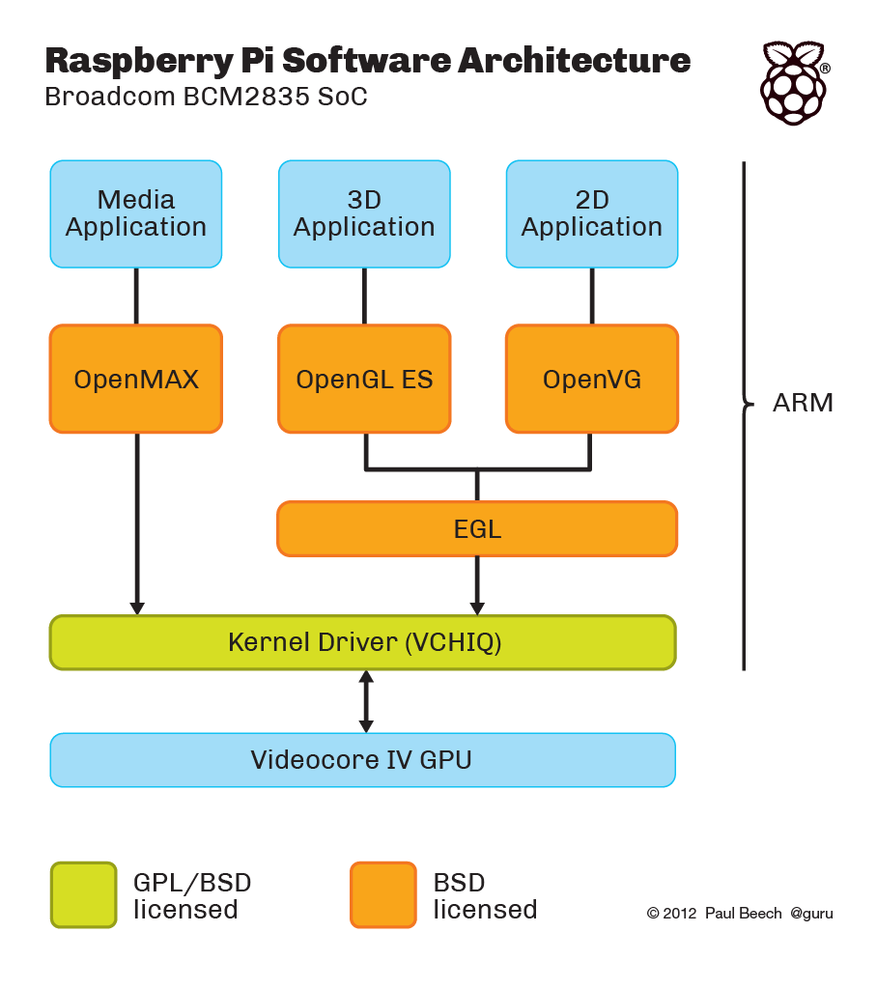
Where those Apis Sit
Notes:
All of this is Open Source

Slide 21
Codec support
Video
H.264 – Blu-Ray, web video (YouTube), HDTV, IPTV
MPEG2 (£2.40) – DVD, SDTV
VC-1 (£1.20) – Windows Media, Blu-Ray
Audio
HE-AAC – HDTV, IPTV, web video, DAB+, Internet radio
AAC – iTunes
MP3 – Music
MP2 – DAB, SDTV, DVD
Dolby + DTS (passthrough)

Slide 22
Useful APIs and Systems
DirectFB
Direct access to the framebuffer for drawing, bliting
Simple DirectMedia Layer (SDL)
Multi-platform API for multimedia, like DirectX
GStreamer
Pipeline based media architecture, like DirectShow
LiRC
Standard system for handling IR remotes

Slide 23
Setup

Slide 24
Flashing an SD card
Two partitions, a FAT32 partition for the bootloader and a ext4 partition for the OS
Windows users should use a program called Win32DiskImager
Linux geeks, you can use dd and figure it out yourself ;-)
If present on image, use raspi-config to make rest of SD card accessible and configure some basic parameters

Slide 25
Getting prebuilt software
Start by installing packages that interest you, it’s just normal Linux
Command line tool, apt-get manages common software packages on Debian variants
Syntax “apt-get install <package>”
Some things will work better than others

Slide 26
Interesting programs
Penguins Puzzle
TinyBASIC
PyGame (Squirrel Eat Squirrel)
RetroArch
Quake 3
Scratch

Slide 27
Omxplayer
A simple command line media player which uses the hardware acceleration capabilities
Best way to “just play something”
May need to be explicit about outputs used
GStreamer is more advanced but is harder to use

Slide 28

High level Coding with Qt5
To the code…

Slide 29
QT5
Cross-platform development environment
Program in a variety of languages
Qt Quick high level UI builder + JavaScript = quick, fast and easy application development
Ideal for designers and web developers
Largely self-contained ecosystem
Runs on a wide variety of hardware and takes advantage of hardware acceleration

Slide 30
Getting Started
Was in Debian Wheezy, disappeared when Raspbian appeared
You can roll your own but you have to compile it first (sorry)
Handy script called bakeqtpi has been developed
Works on Linux and OSX
Can develop on your PC then deploy to Raspberry Pi (Windows, Linux, Mac)
Easier to get started with Qt Creator IDE

Slide 31
How does QtQuick work?
Easiest way is to write one or more .qml files and execute them using qmlscene
Eventually you can build a binary and complement with native code
QML = Qt Markup Language
Syntax consists of describing objects and their properties
JavaScript can be inline or external files

Slide 32
Hello, world
import QtQuick 2.0
Rectangle
{
id: main
width: 1280
height: 720
color: "white"
Text {
id: hello
text: "Hello, world"
font.pointSize: 48
color: "black"
}
}

Slide 33
Qt5 demo

Slide 34
Low level Hardware Interfacing

Slide 35

Low level I/O
When people tell you programming is just 1s and 0s…
…they’re right you just haven’t entered The Matrix yet
Photo used under Creative Commons from EJP Photo

Slide 36
What’s on the Pi
2 x 13 pinout (some changes on Rev 2)
3.3V and 5V power pins plus ground
8 x GPIO pins
I2C
SPI
UART
PWM

Slide 37
GPIO programming
GPIO = General Purpose Input Output
The signals on these pins have no specific pre-defined purpose, you are free to control them as you wish
Simplest and most flexible construct
Most basic use is enable/disable
Time and or multiple pins can be used for more complex functionality
Pure software IO is called “bit banging”
IR remote control/receiver

Slide 38
SPI
Serial Peripheral Interface Bus
Hardware support
4 pins useds
Serial clock
Output
Input
Chip select
Many useful applications

Slide 39
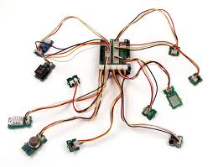
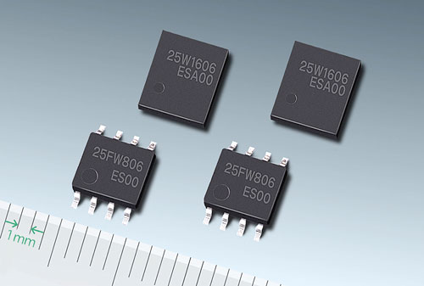
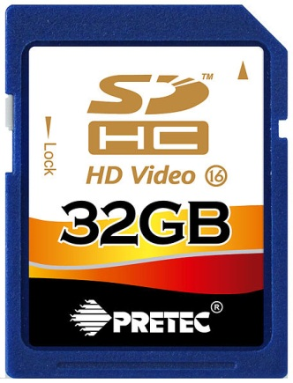
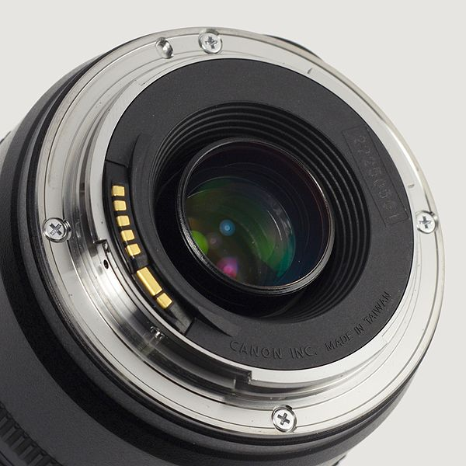
Spi applications

Slide 40
I2C
Inter-Integrated Circuit (or 2 wire)
Just clock and data pins
Very common and widely used
Very easy to program just write device addresses, sub-address (optional) and data

Slide 41
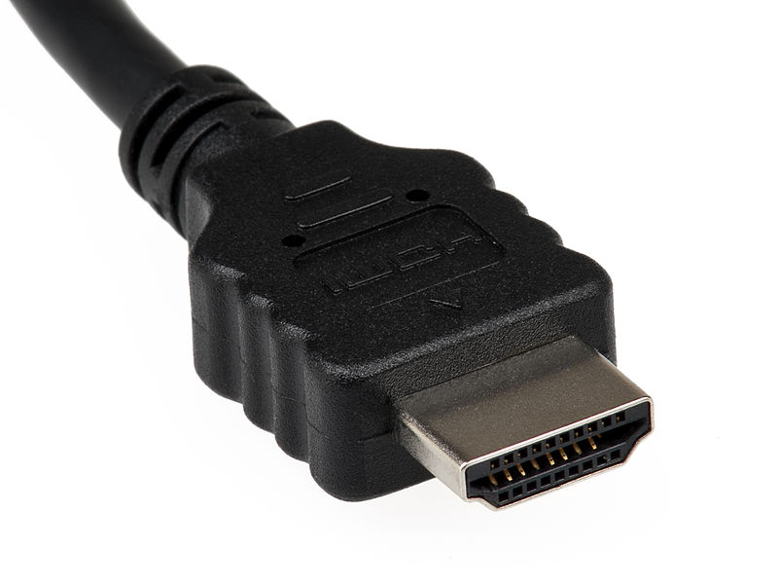
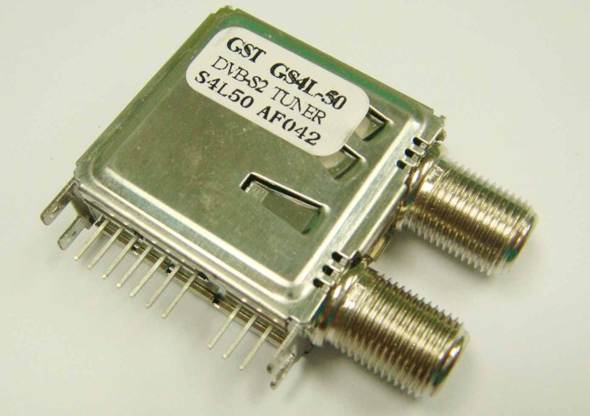
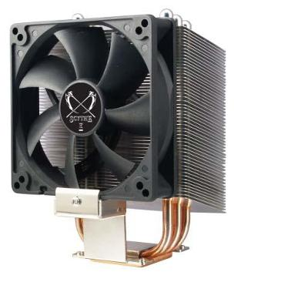
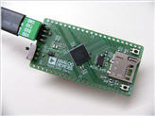
I2C Applications

Slide 42
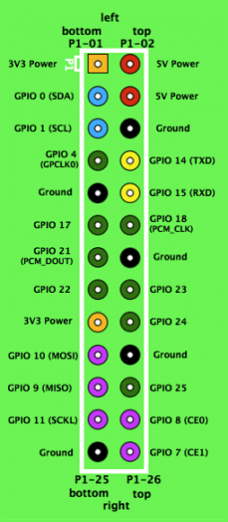
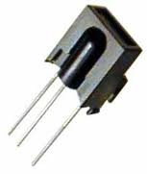
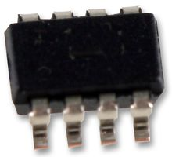
Raspberry Pi Pinout
Colour legend
+5 V
+3.3 V
Ground, 0V
UART
GPIO
SPI
I²C
Make sure you know where pin 1 is!

Slide 43
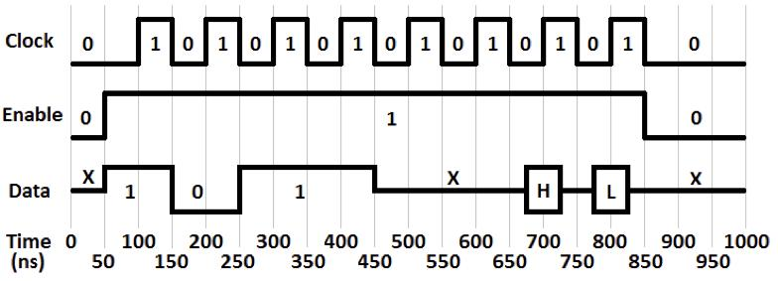
Clocks
1 = high, 0 = low
FALLING EDGE

Slide 44
Two ways to code C/C++
On the target platform directly with normal GNU toolchain make, gcc, etc
Cross compiling from your host (PC) to the target (Pi)
Cross compiling toolchain run on the host but the binaries run on the target
More involved but will be far quicker especially for large complex projects

Slide 45
Summary
Hardware and API available
Setting up your Pi
Talked about some apps
Introduced Qt5
Covered low level programming

Slide 46
That’s all folks
Follow me on Twitter @DougGore
Any questions?

